Slide 1
Neuromorphic Architectures for Spiking Deep Neural Networks
Giacomo Indiveri - Federico Corradi - Ning Qiao

Slide 2
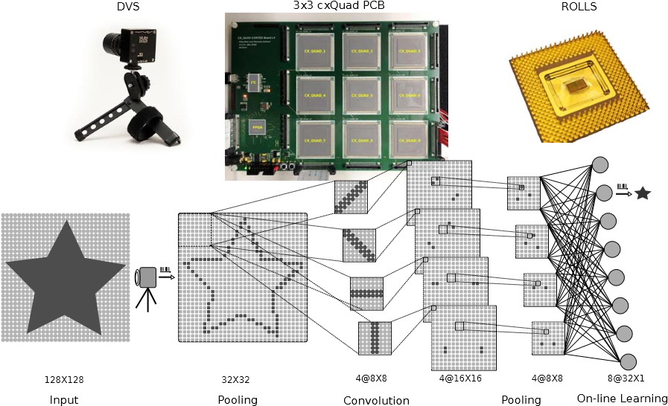
Experimental setup
Notes:
a Dynamic Vision Sensor (DVS) converts moving visual stimuli displayed on a screen into streams of Address-Events (AEs).
The DVS retina responds only to changes in the scene contrast and provides in output continuous streams of AE which report the location of the pixels that sensed the changes.
The retina AEs are subsampled and re-mapped onto the first chip of the cxQuad Printed Circuit Board (PCB) via a direct cable connection. The spiking output of the first chip is decomposed into multiple streams to implement a 2-layer convolutional network.
classification layer implemented on the ROLLS neuromorphic processor, which is configured to implement ensembles of perceptrons for classifying the extracted features.

Slide 3

Convolution Layer (1 kernel to 1 map)

Slide 4
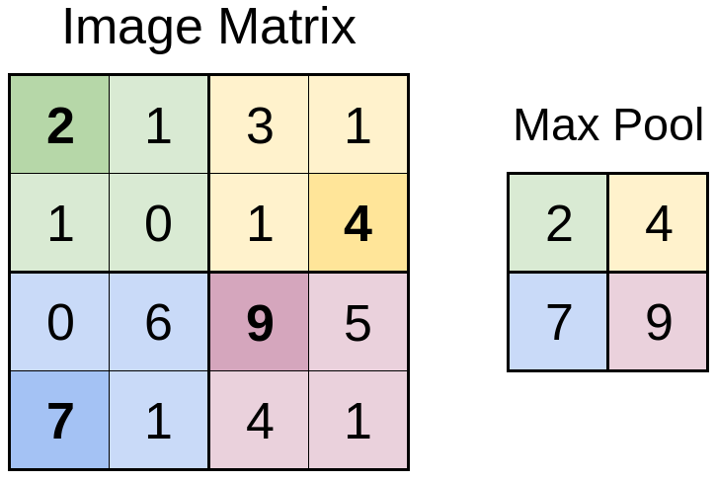
Spatial Max Pooling

Slide 5
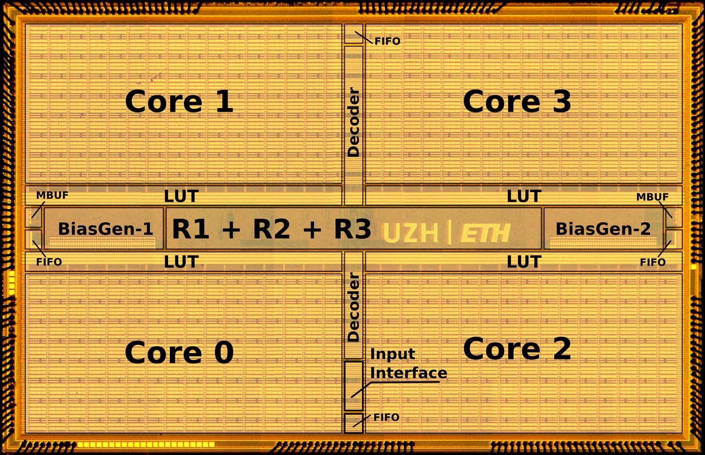
cxQuad chip

Slide 6
cxQuad Chip
Multicore (Analog neuron + synapse)
Comprises Asynchronous digital routing fabric
log domain Differential Pair Integrator + adaptive Integrate and Fire (I&F) neuron circuit
Address event Representation (AER) route spikes among neuron within a core, across cores and across chips boundaries.

Slide 7
cxQuad chip
1K neuron
64K synapse among 4 cores
16 * 16 unit (1 neuron and synapse block in each unit) in each core
Each synapse block comprises linear integrator circuit which integrates input events from 64 12-bit programmable Content Addressable Memory (CAM)
Output events generated by the neurons can be routed to the same core, via a Level-1 router, to other cores on the same chip, via a Level-2 router, or to cores on different chips, via a Level-3 router

Slide 8
cxQuad chip
The memory used by the routers to store post synaptic destination addresses is implemented using 4k 12-bit Static Random Access Memory (SRAM)s blocks distributed among the Level-1, 2, and 3 router circuits.

Slide 9
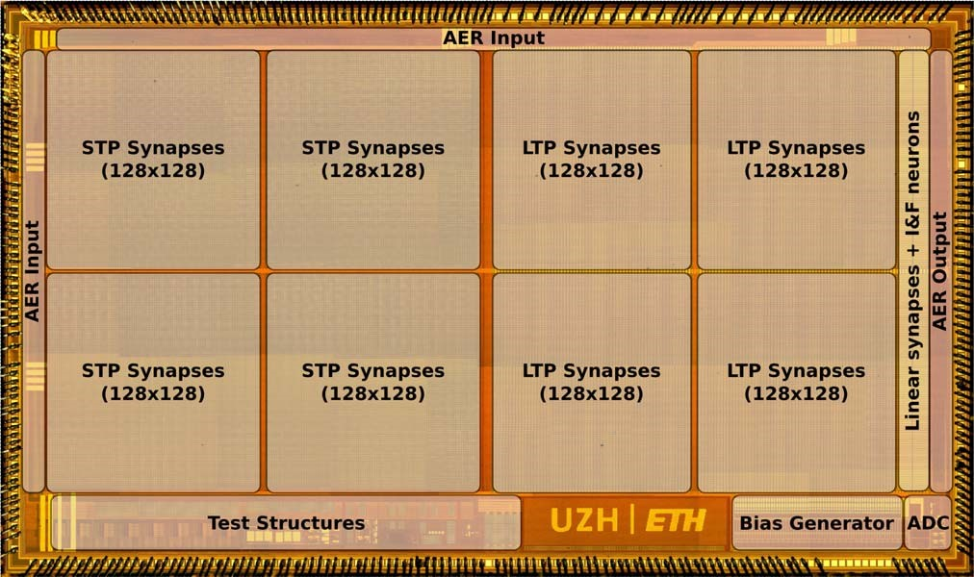
ROLLS chip (layout)

Slide 10
ROLLS Chip
64k STP programmable synapses, 64k LTP learning synapse, 256 shared synapses, and 256 analog neurons.
comprises digital AER input/output blocks, an on-chip temperature compensated bias generator, and analog current/voltage to spike-frequency converters.
neuron circuits are the same ones integrated onto the cxQuad chip
Implement a type of Adaptive Exponential (AdExp) Integrate and Fire (I&F) model

Slide 11
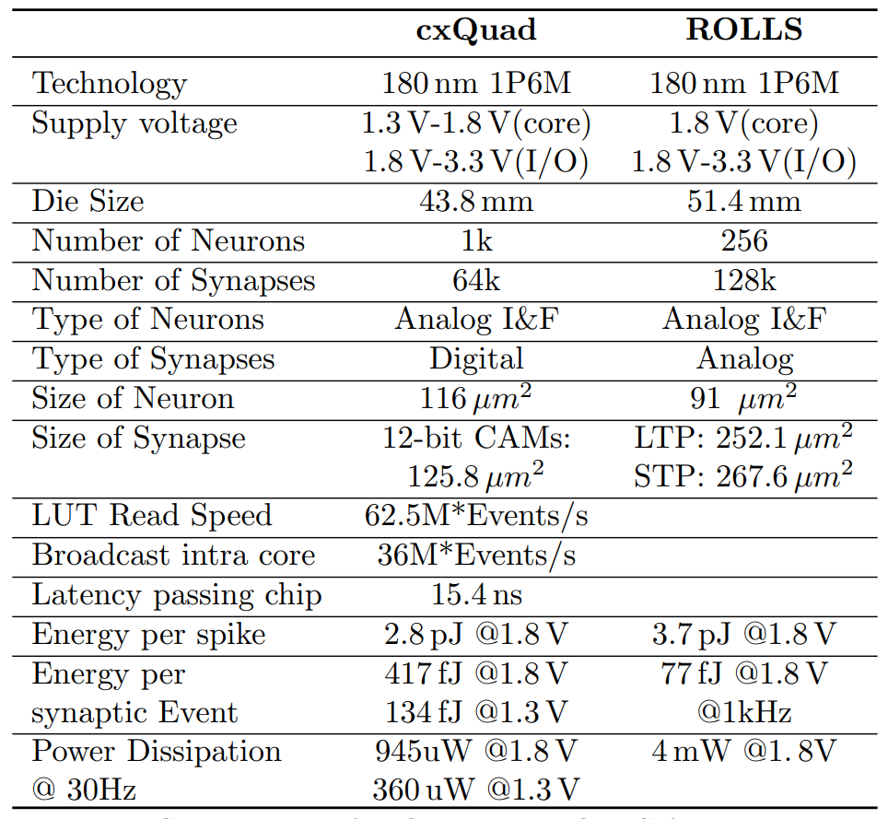
Comparison of cxQuad and ROLLS features

Slide 12
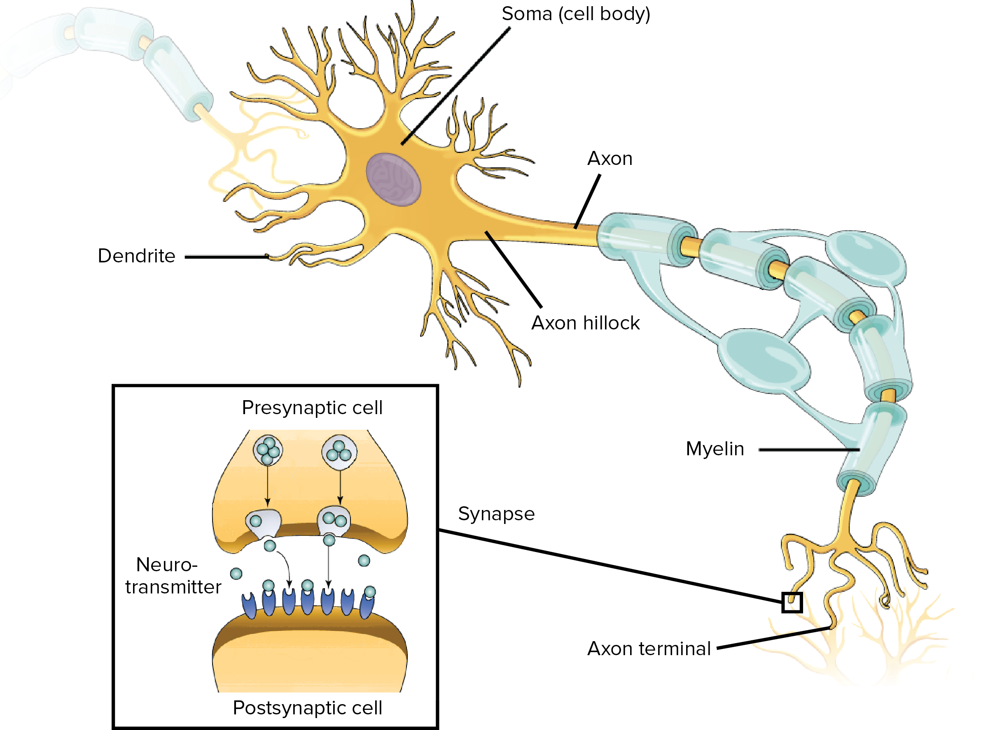
Biological Neuron

Slide 13
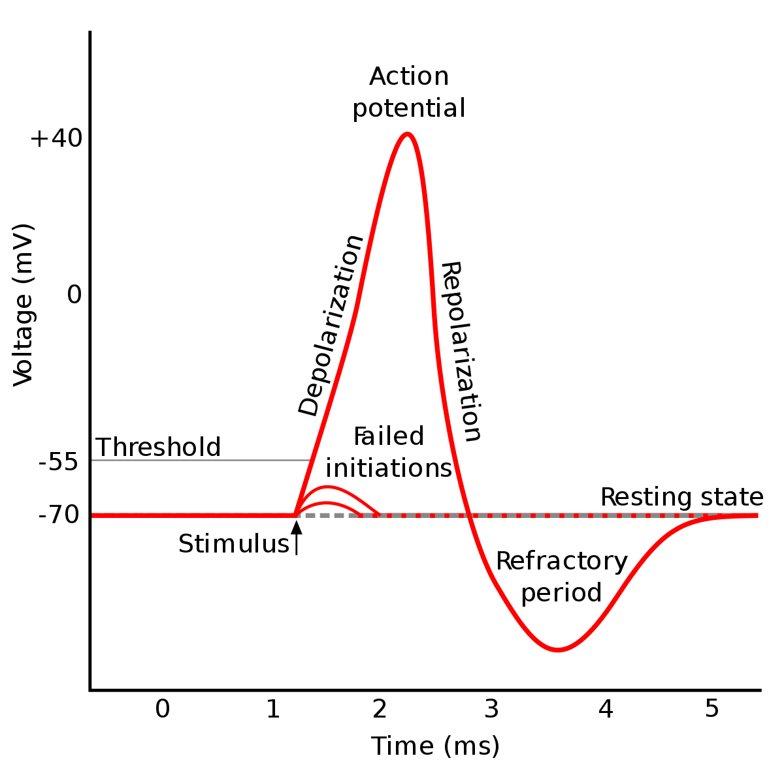
Biological Neuron Membrane Action Potential
Hyperpolarisation

Slide 14
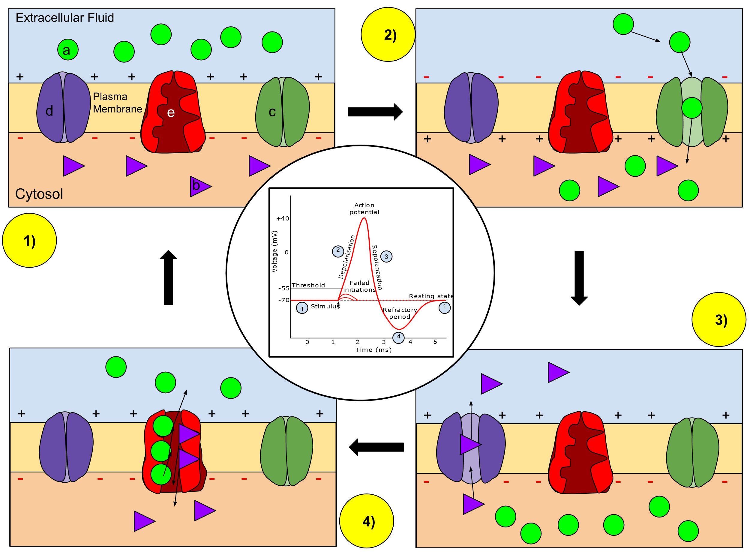
Notes:
Ion movement during an action potential. Key: a) Sodium (Na⁺) ion. b) Potassium (K⁺) ion. c) Sodium channel. d) Potassium channel. e) Sodium-potassium pump. In the stages of an action potential, the permeability of the membrane of the neuron changes. At the resting state (1), sodium and potassium ions have limited ability to pass through the membrane, and the neuron has a net negative charge inside. Once the action potential is triggered, the depolarization (2) of the neuron activates sodium channels, allowing sodium ions to pass through the cell membrane into the cell, resulting in a net positive charge in the neuron relative to the extracellular fluid. After the action potential peak is reached, the neuron begins repolarization (3), where the sodium channels close and potassium channels open, allowing potassium ions to cross the membrane into the extracellular fluid, returning the membrane potential to a negative value. Finally, there is a refractory period (4), during which the voltage-dependent ion channels are inactivated while the Na⁺ and K⁺ ions return to their resting state distributions across the membrane (1), and the neuron is ready to repeat the process for the next action potential.

Slide 15
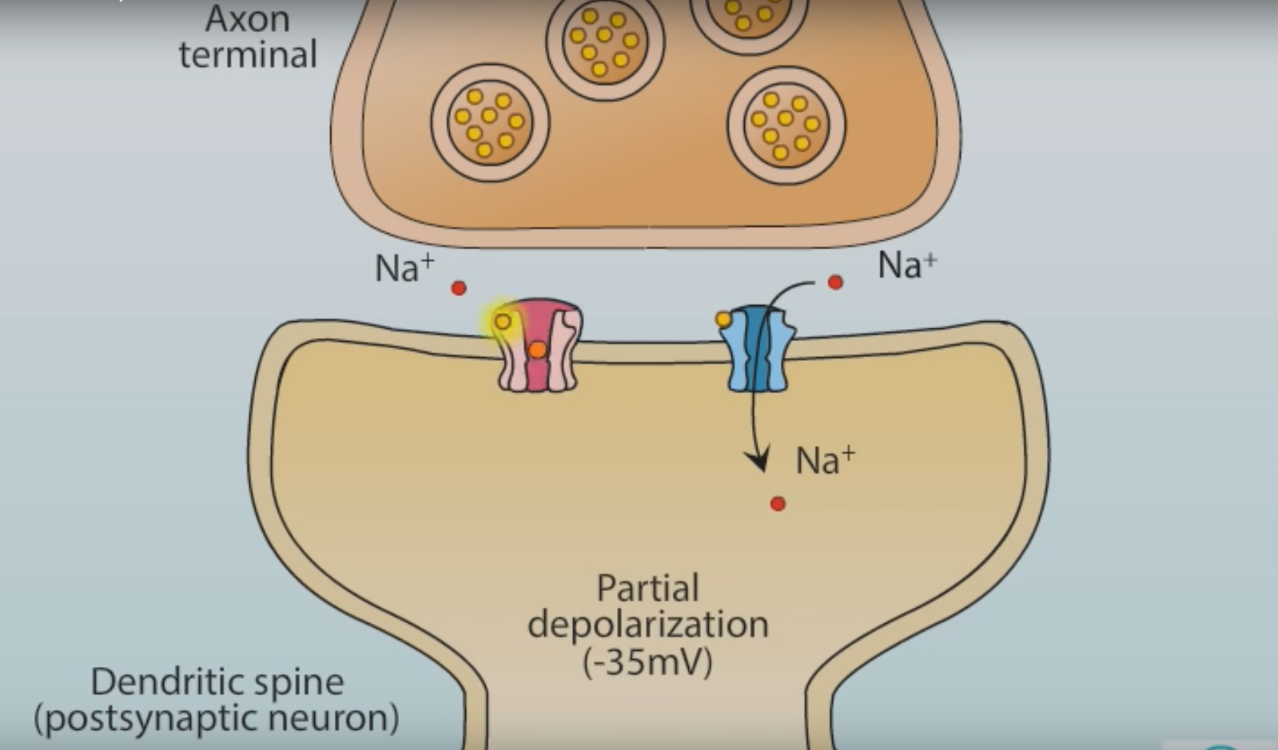
Synaptic plasticity (NMDA and AMPA Receptors)

Slide 16
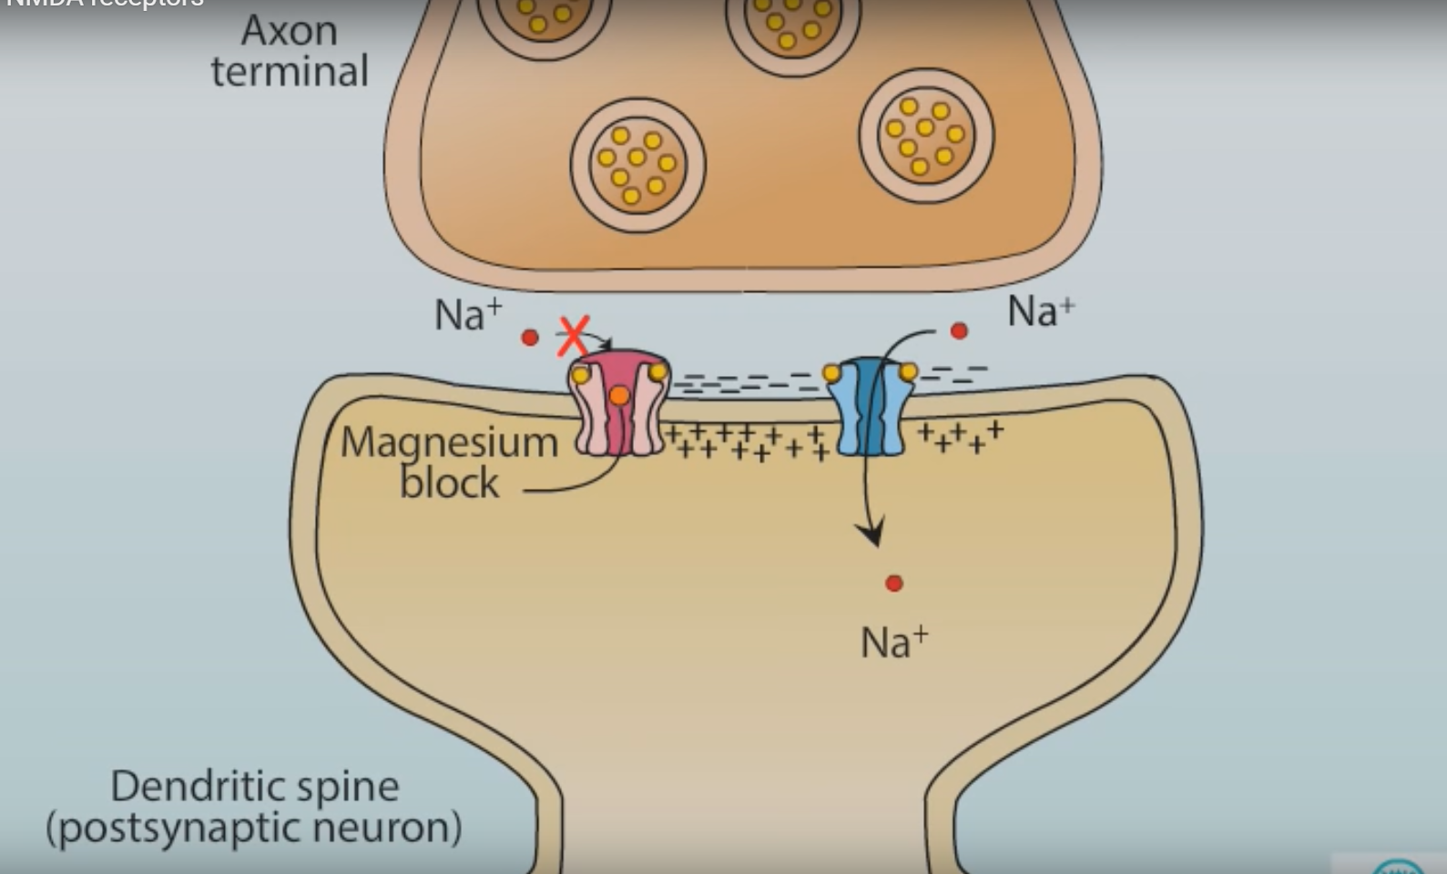
Synaptic plasticity (NMDA and AMPA Receptors)
Notes:
pre-synaptic stimulation with sufficient strength and frequency, causes AMPA receptor to depolarise NMDA receptor,

Slide 17
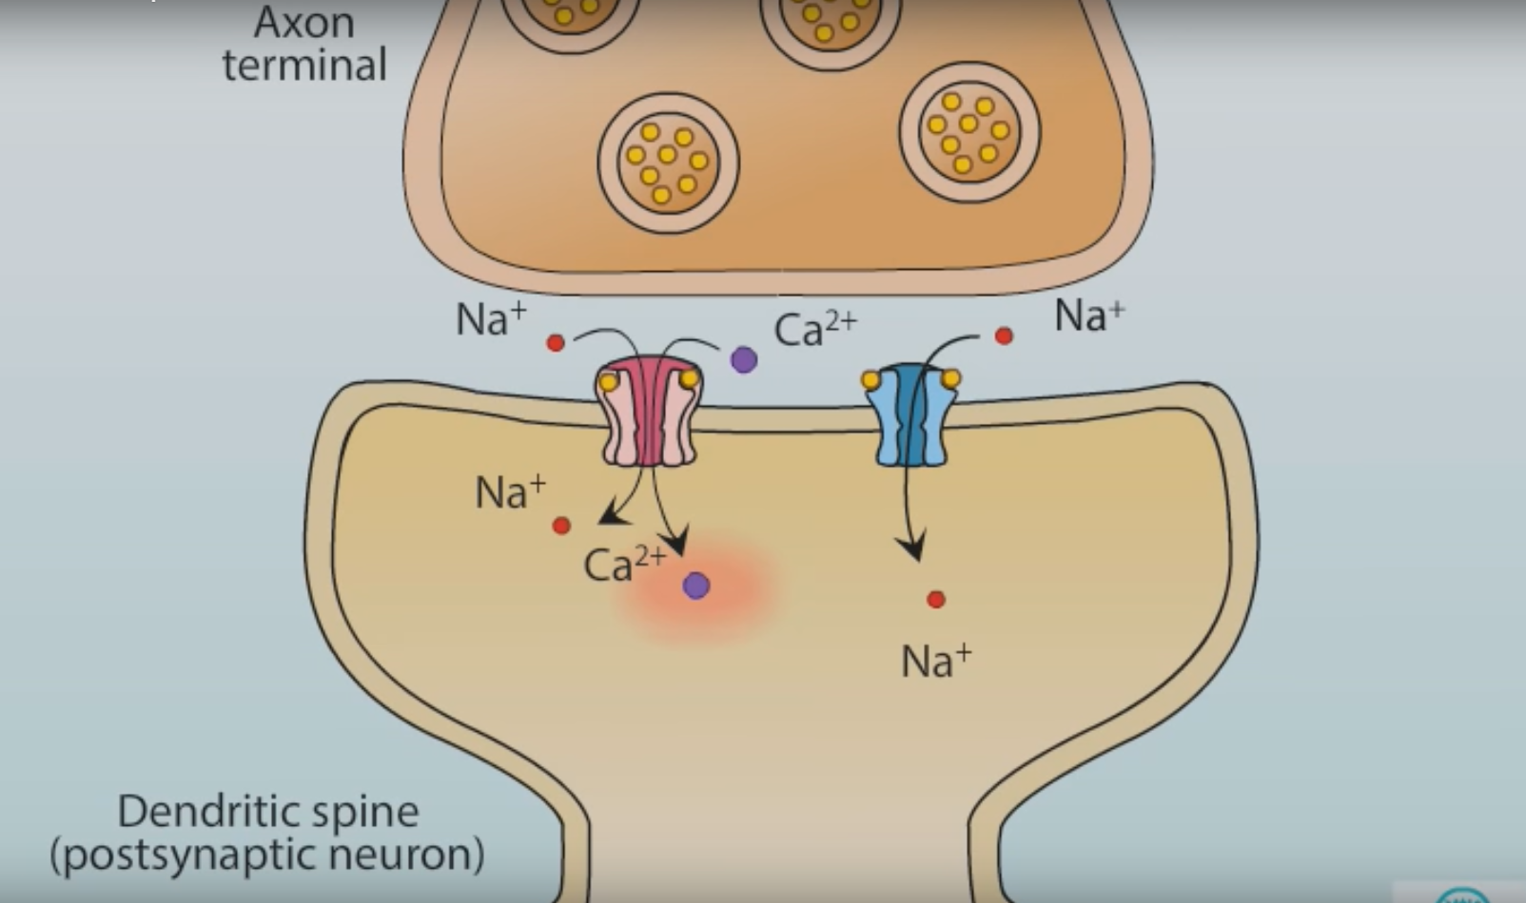
Synaptic plasticity (NMDA and AMPA Receptors)
Notes:
NMDA now admit not only sodium but also calcium ion. Calcium is important neuron transmitter, as it activates cellular signalling cascade through binding to cam kinase

Slide 18
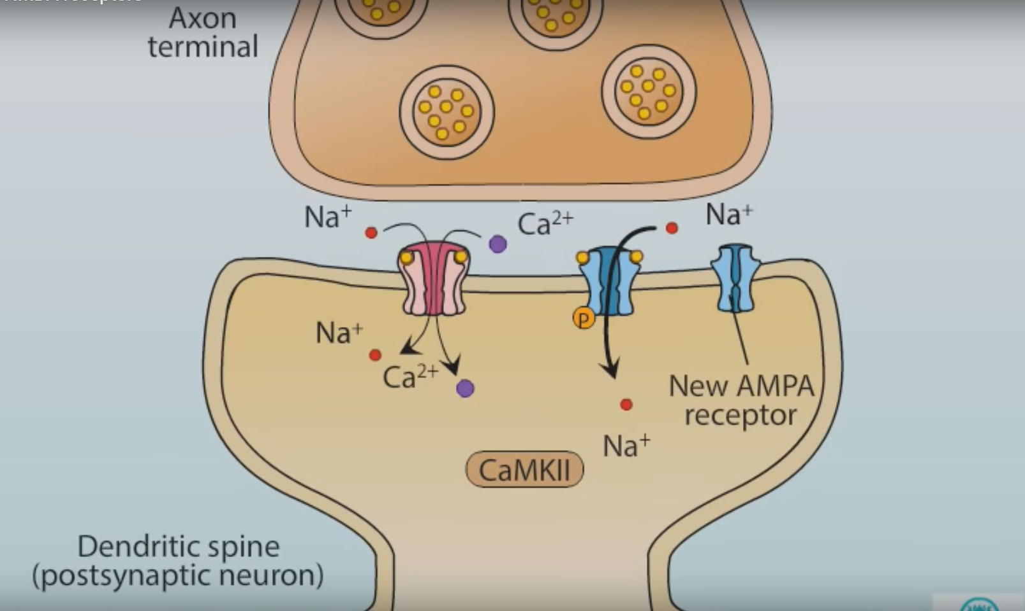
Synaptic plasticity (NMDA and AMPA Receptors)
Notes:
Calcium bind to Cam kinase, resulting in new AMPA receptor movement into the membrane from intracellular store

Slide 19

Synaptic plasticity (firing timing)

Slide 20
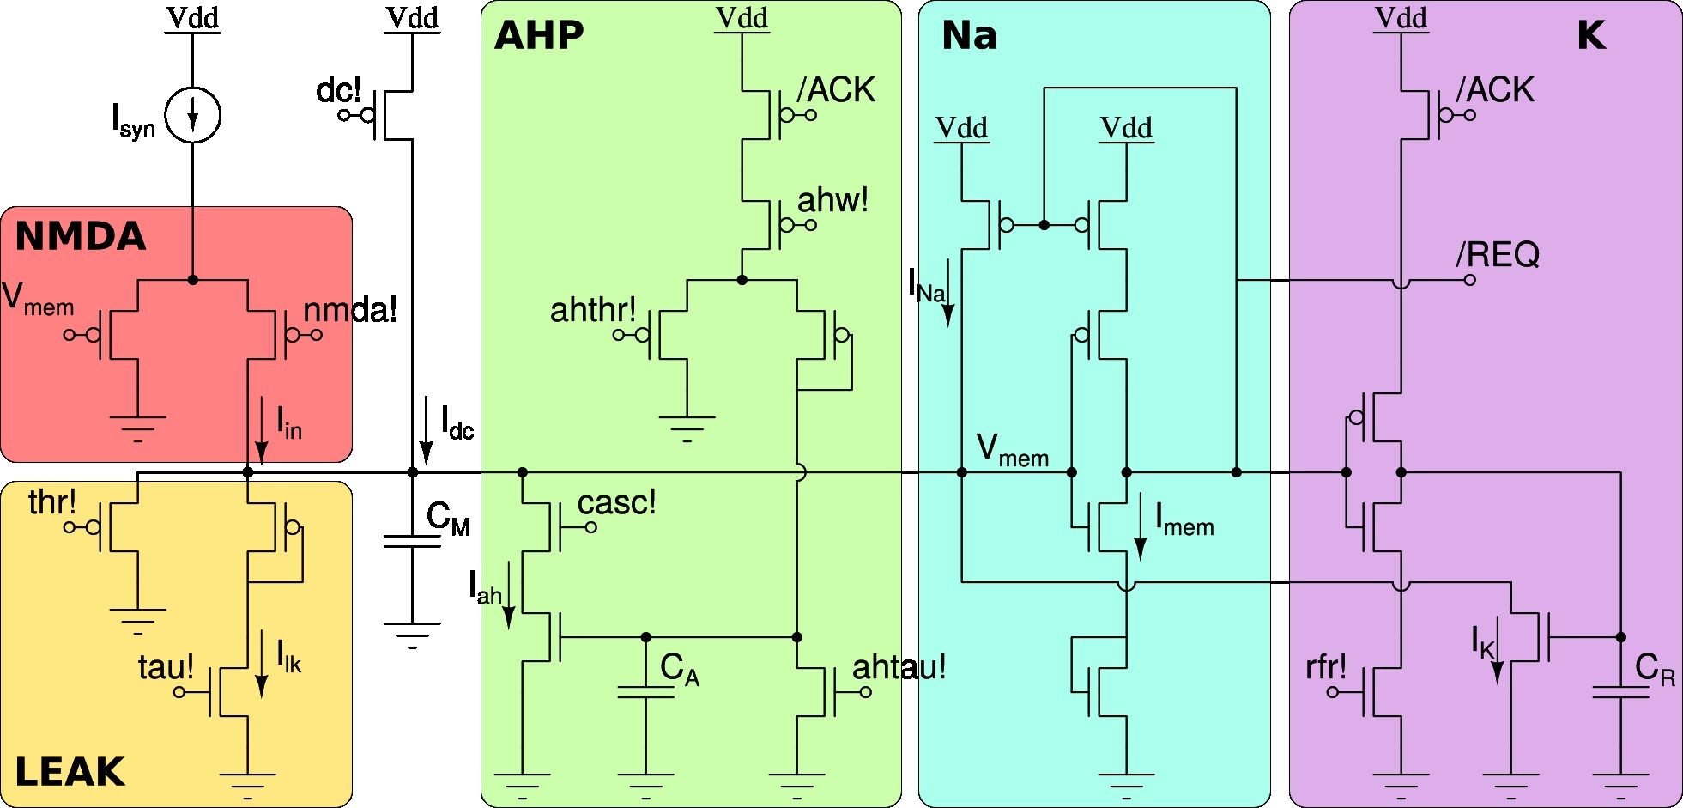
Simplified schematic diagram of the cxQuad and ROLLS chips neuron circuit

Slide 21
What’s happening in this circuit
The sum of all synaptic input currents Isyn is integrated onto the capacitor CM, in parallel with a possible DC current Idc. A differential pair at the input (see NMDA block) models the voltage gating mechanism of NMDA-type synapses, while the LEAK block implements the leak conductance of conductance-based neuron models. As the input currents are integrated, the neuron’s output current Imem increases. Eventually, the NA block activates a positive feedback mechanism that produces a sharp increase in the output and generates a fast spike. After the spike reset, the membrane capacitor CM is actively kept discharges by the K block, thorough the IK current for a set refractory period. With every spike, an adaptation current Iah is increased. As this current, which models the neuron’s afterhyper-polarizing current, is subtracted from the input, the output spike frequency decreases. This negative feedback mechanism models the neuron’s spike-frequency adaptation effect. At the same time, with every spike, a digital REQ signal is produced to activate the asynchronous digital AER circuits, for the chip Input/Output (I/O) communication circuits.

Slide 22
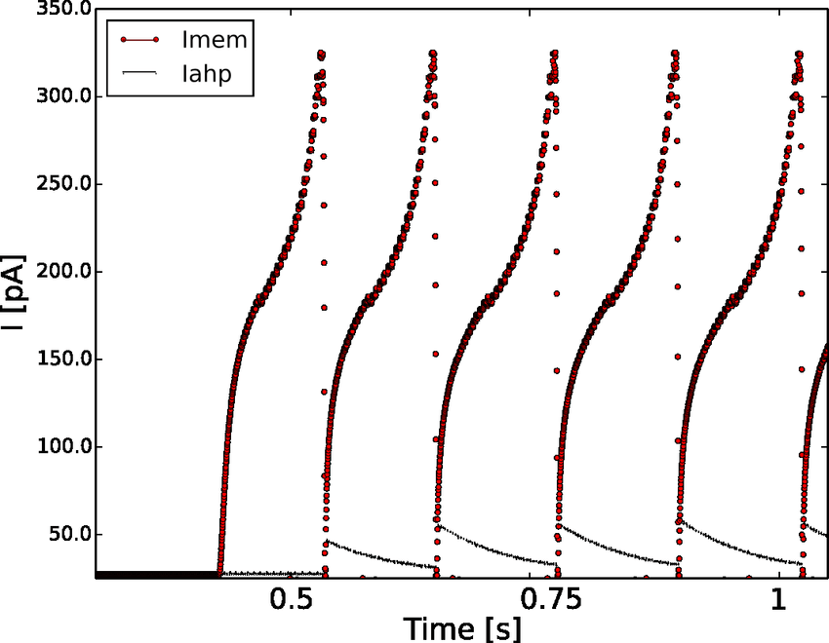
Silicon neuron output current (I_mem) and adaptation current(I_ahp) vs Time (s)
Notes:
Silicon neuron output current Imem and adaptation current Iahp measured from one of the ROLLS neuron circuits in response to a step input current activated at t=0.3 s

Slide 23
Supervised Training of ROLLS
Neurons receive a high-frequency teacher signal to induce increases in the weights of the stimulated synapses.
Those synapse belongs to neurons that did not receive the teacher signal during that stimulus presentation tended to decrease their efficacies

Slide 24
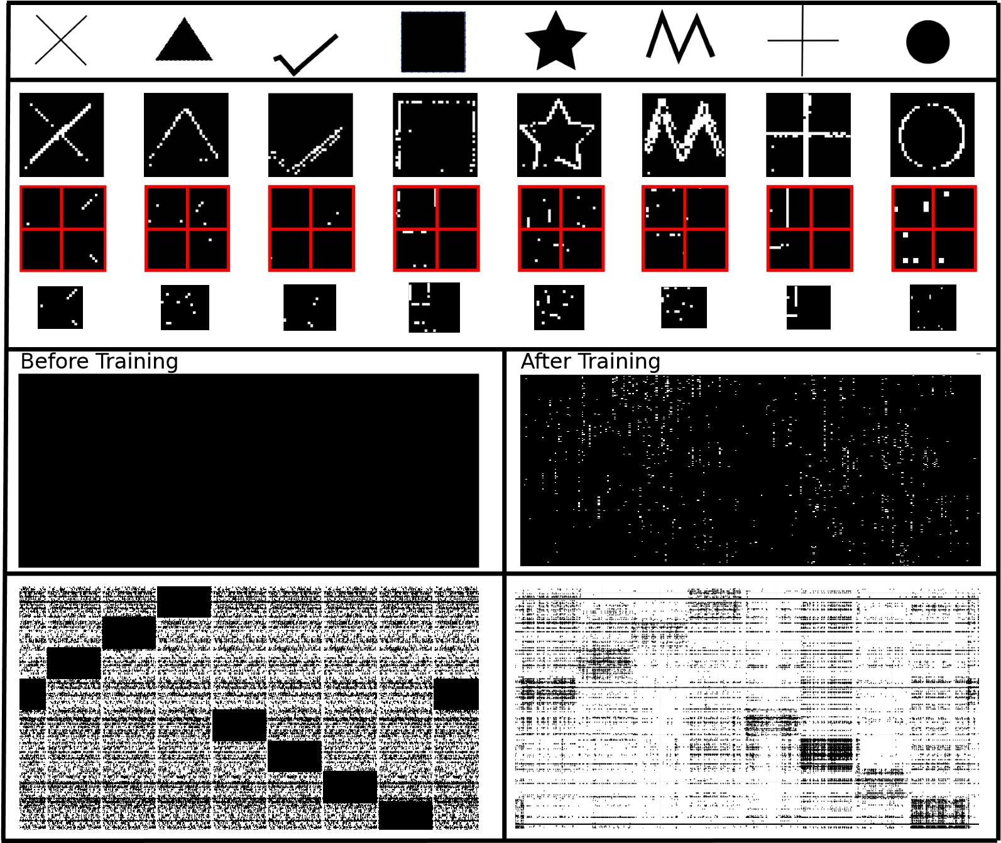
Convolution and learning with the cxQaud and ROLLS chips
Notes:
8 visual input stimuli
activations of the three input convolution and pooling layers, implemented by the cxQuad board (white dots represent neuron spiking activity).
the state of the ROLLS LTP bi-stable synapses before and after training. Black pixels (low weights) and white pixels (high weights).
the spiking activity during the training phase (left), and the test phase (right). Each dot in the plot represents a spike. The horizontal axis represents time and the vertical axis the neuron address.
High activity regions in the left plot denote the presence of the teacher signal superimposed to the input; high activity in the right plot shows how the ensemble of neurons stimulated by the stimulus it was trained to recognize produces a higher activity, compared to all other neurons in the same vertical region.

Slide 25
Conclusion
Demonstrate the feasibility of the setup
Highlight the low-latency and low-power performance
Can potentially solve the von Neumann bottleneck problem for dedicated DNN computing platforms.
Useful for real-time sensory processing applications and for being integrated in embedded systems.

Slide 26
Spiking Deep Convolutional Neural Network for Energy-Efficient Object Recognition
Yongqiang Cao – Yang Chen – Deepak Khosla

Slide 27
Why Convolutional Neural Network (CNN)?
suitable for difficult vision problems
Why Spiked Based Neuromorphic CNN?
Conventional CNN algorithms are becoming increasingly complex and often require more powerful computing platforms
Can take advantage of the emerging class of ultra-low power spike-based hardware architectures

Slide 28
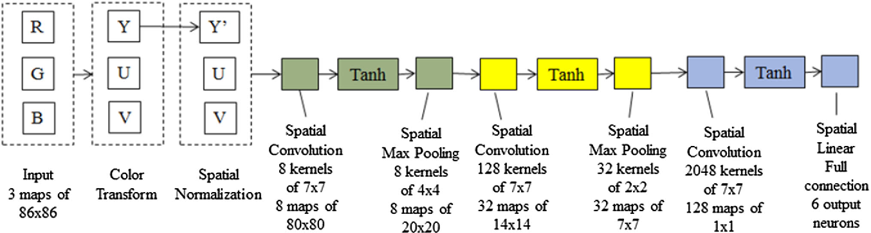
A typical CNN architecture with 3 convolution layers and a fully connected classification layer

Slide 29
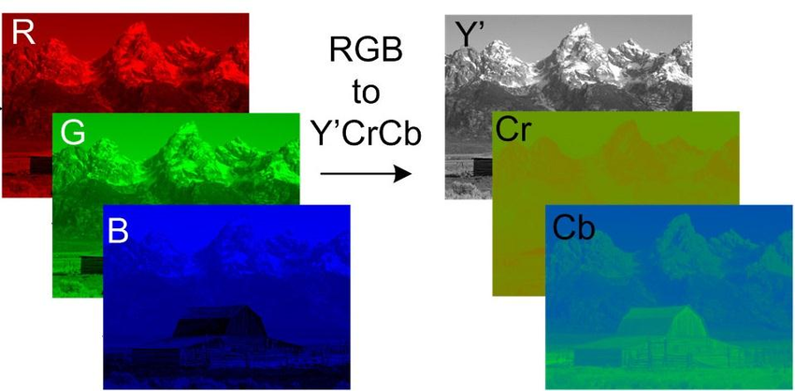
RGB to YUV (Y’CrCb)

Slide 30
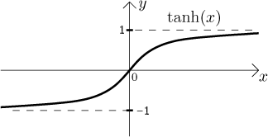
Tanh(x)

Slide 31
Challenges in Implementation
Negative output values in CNN layers are more difficult to be represented accurately in SNN. Negative sources:
The sigmoid function tanh() has output values between -1.0 and 1.0
In each convolution layer, the values of each output feature map are weighted sums of inputs plus biases. These can be negative.
Output values from preprocessing (e.g., color transform and spatial normalization) can produce negative values
No good way to represent biases in spiking networks (Can be +ve or –ve)
Max-pooling requires two layers of spiking networks -> need more neurons

Slide 32
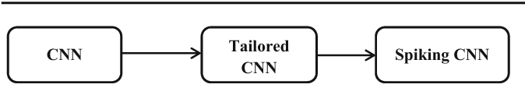
Flow-diagram of converting a CNN into SNN architecture

Slide 33
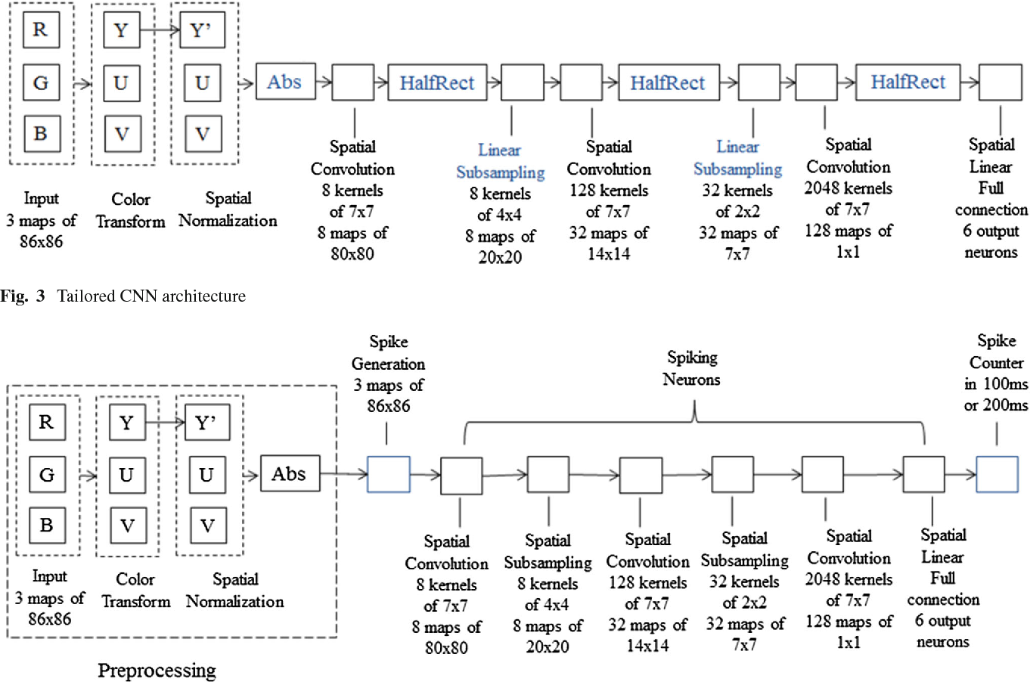
Tailored CNN architecture

Slide 34
Tailored CNN architecture
Make output values in all layers positive:
Use abs() , omitted when used RGB (already positive)
Change tanh() to HalfRect() (means rectified linear units - see next slide)
Remove biases from all convolution and the fully connected layers (i.e set bias to 0).
Use spatial linear subsampling instead of spatial maxpooling. The spatial linear subsampling adds all pixels over a small image neighborhood using a kernel of uniform weights which sum to 1.0 (easy to convert to spike)

Slide 35
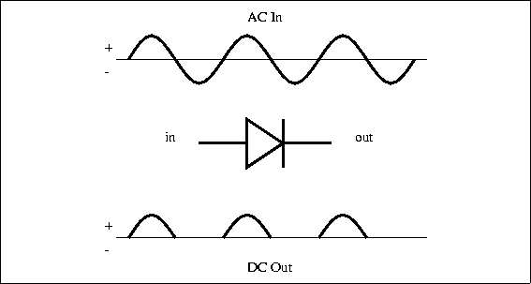
HalfRect

Slide 36
Spike Based CNN Architecture

Slide 37
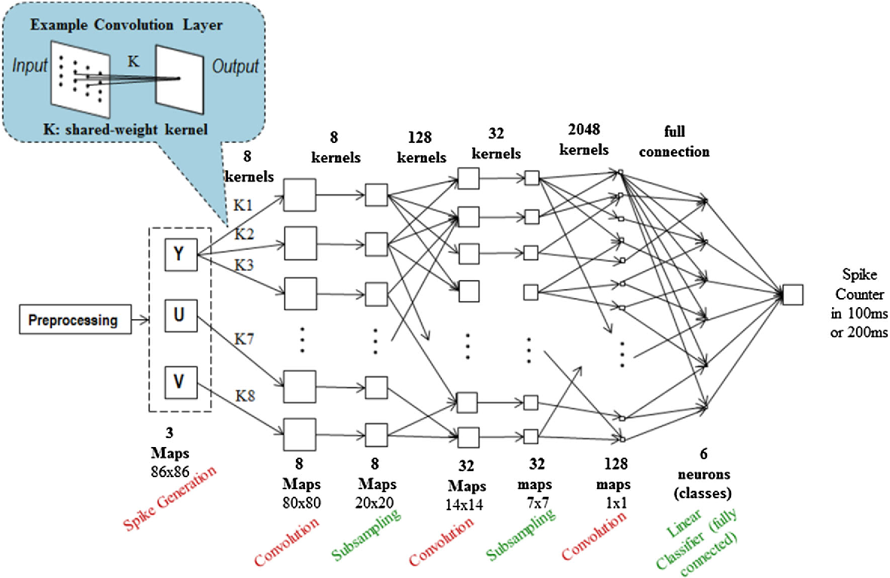
Detailed Spiking CNN (SNN) architecture

Slide 38
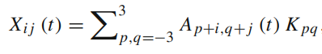
Spike Based CNN Architecture
Everything else the same but with new addition:
Spike Generation
Spike Counter
No more halfRect (Spike based already means halfrect)
Kernel weight is now synaptic strength (means the same)
All biases set to 0
Membrane potential from I&F (see next slide for more info):
V (t) = V (t − 1) + L + X(t),
If V (t) ≥ θ , spike and reset V (t) = 0,
If V(t) < Vmin, reset V(t) = Vmin
Where

Slide 39
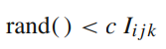
Spike Based CNN Architecture
L is the constant leakage parameter
Θ is the threshold
A is input spikes (0 or 1) from previous layer
K is the synaptic weight
Spike Generation:
At time t, neuron (i, j) in the kth image map produces a spike if:
Where:
rand() is a random number generator with uniform distribution on (0.0, 1.0)
c is a constant to scale the frequency of spikes generated

Slide 40
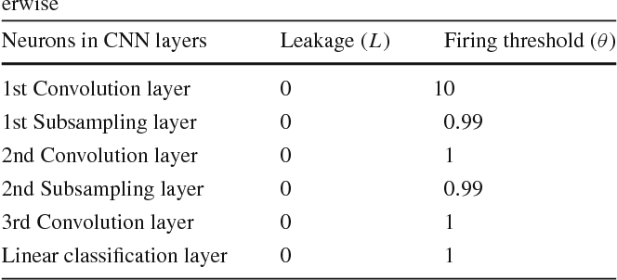
Parameters of spiking neurons in SNN simulator

Slide 41
Neovision2 Tower Dataset 026

Slide 42
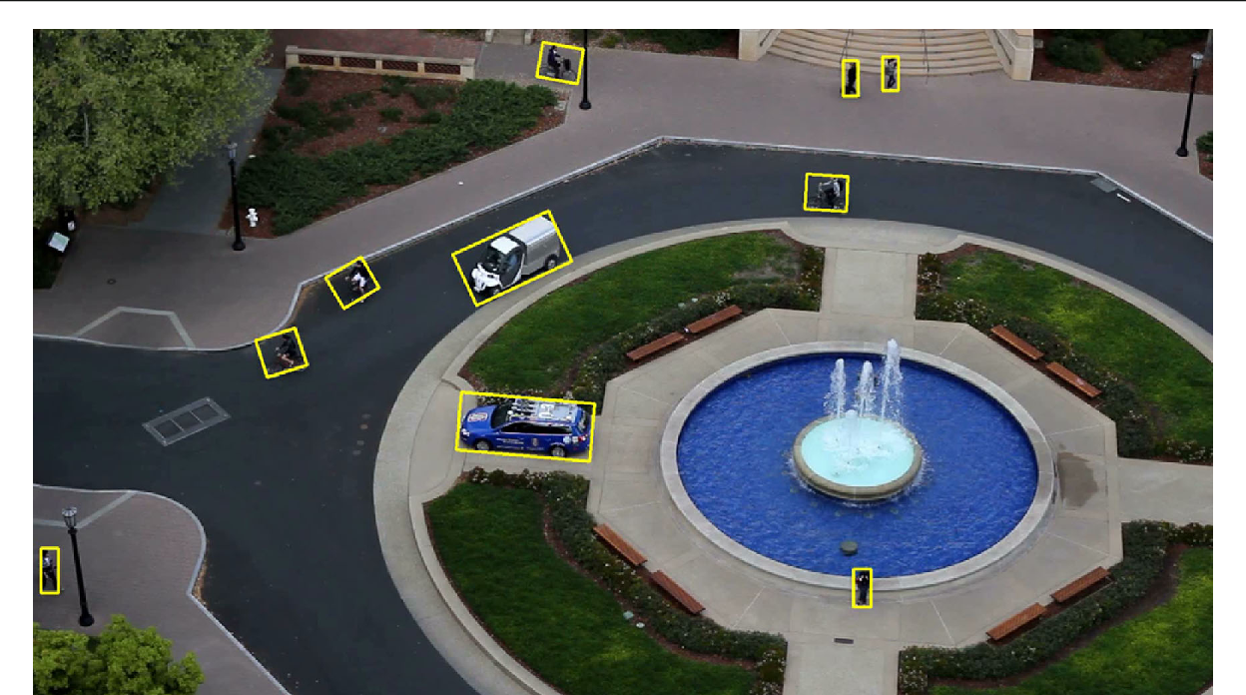
Sample image frame from DARPA Neovision2 Tower data set with ground truth objects highlighted

Slide 43
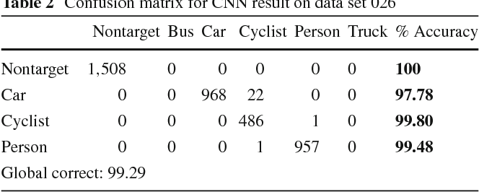
Confusion matrix for CNN result on data set 026

Slide 44
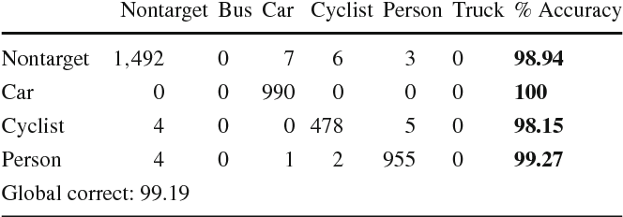
Confusion matrix for tailored CNN result on data set 026

Slide 45
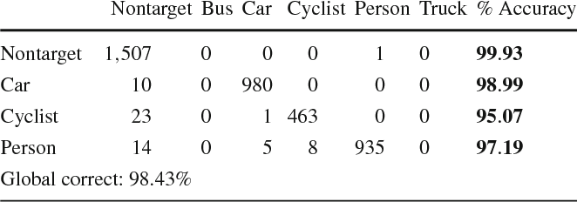
Confusion Matrix for SNN result on data set 026 (T = 100ms)

Slide 46
CIFAR-10 Dataset 027

Slide 47
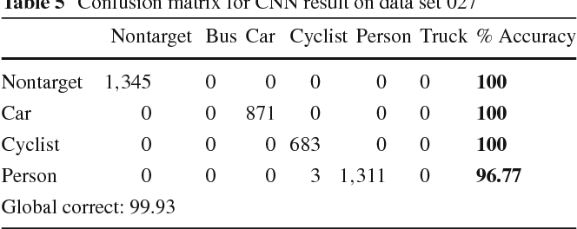
Confusion matrix for CNN result on data set 027

Slide 48
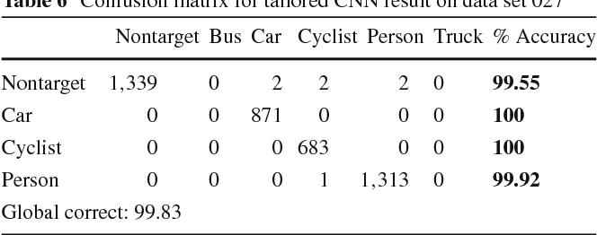
Confusion matrix for tailored CNN result on data set 027

Slide 49
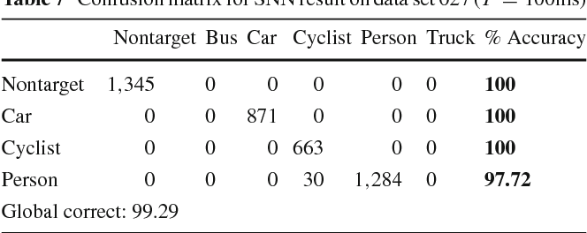
Confusion Matrix for SNN result on data set 027 (T = 100ms)

Slide 50
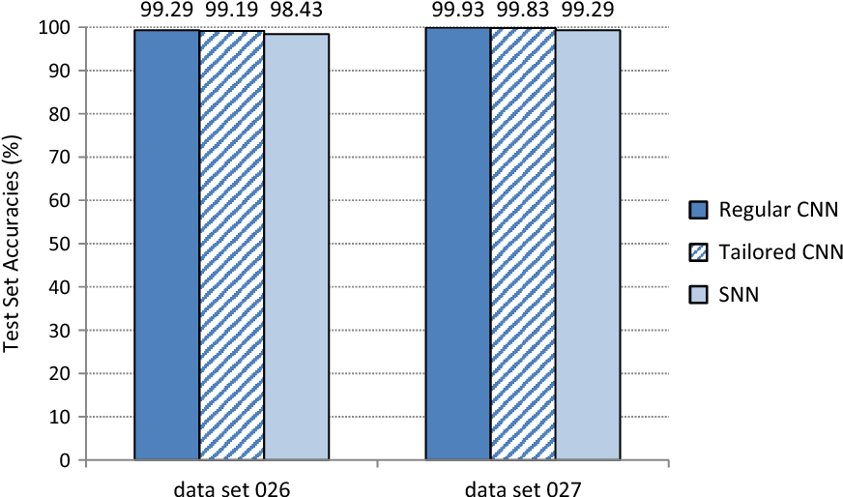
Comparison summary of Tower test set accuracies (global correct %) of regular, tailored and spiking implementations of CNN

Slide 51
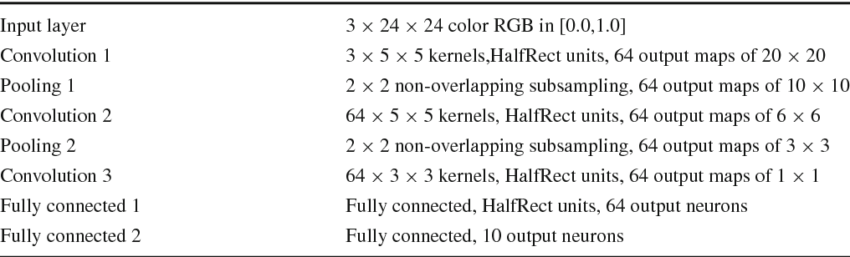
CNN baseline model for CIFAR-10 (with softmax output layer omitted)

Slide 52
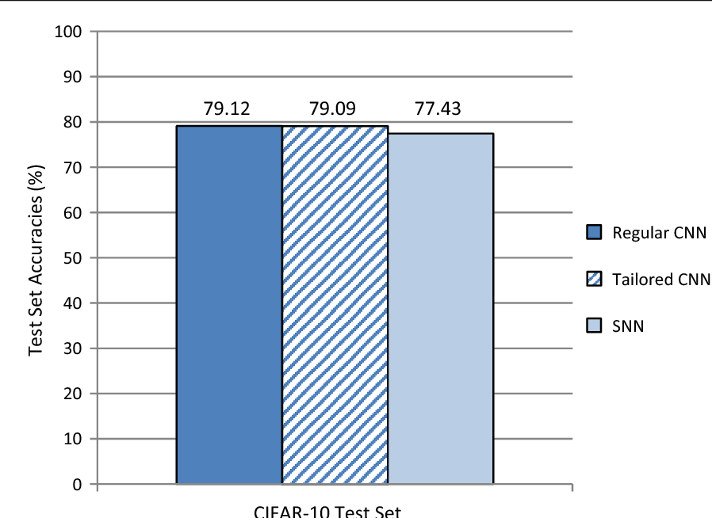
CIFAR-10 test set performance of the baseline CNN model

Slide 53
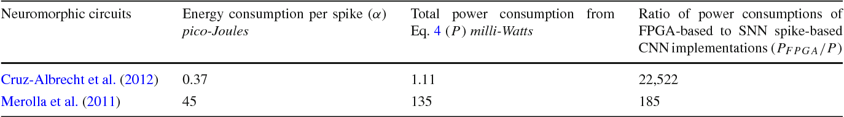
Estimates of SNN power consumption mapping to spike-based hardware

Slide 54
Conclusion
High energy efficiency
High performance of stateof-the-art CNN for object recognition
SNN architecture is more than two orders of magnitude energy-efficient vs e traditional FPGA-based CNN
Scales as the original CNN
No need learning in spike domain, just need conversion from original CNN

